Slide 1
Radio Transceiver Recap

Slide 2
What and Why
Wireless communication link between robot and host/remote controller
Ability to 'assist' robot with SRB board
Driving, escaping, enemy is on the left/right, …

Slide 3
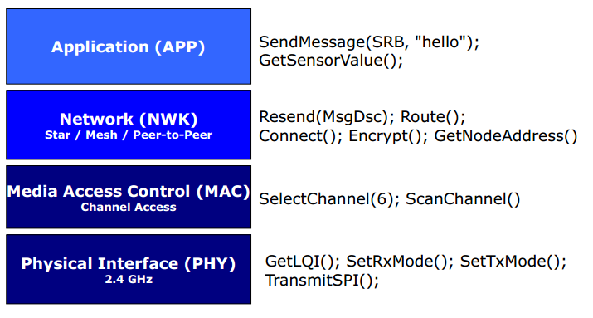
IEE802.15.4
Responsibility
Modularity
Scalability

Slide 4
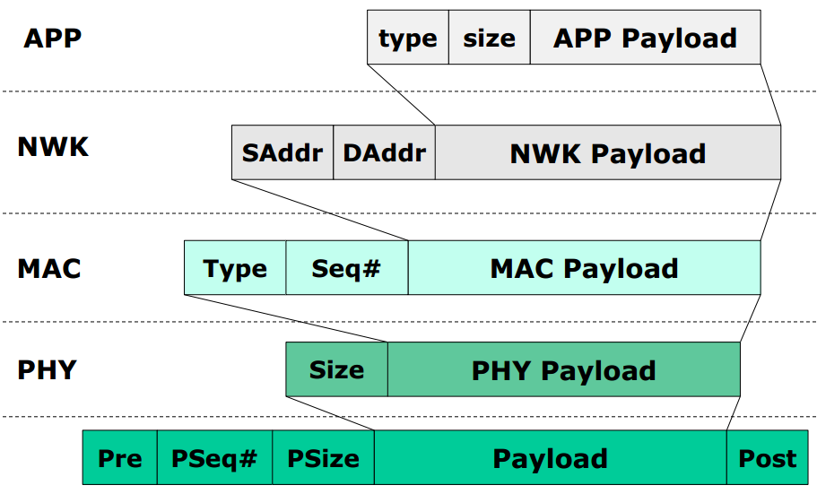
Payload Packaging

Slide 5
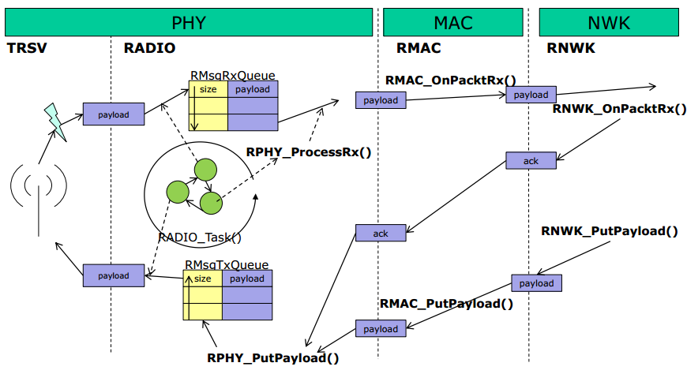
Payload Handling

Slide 6
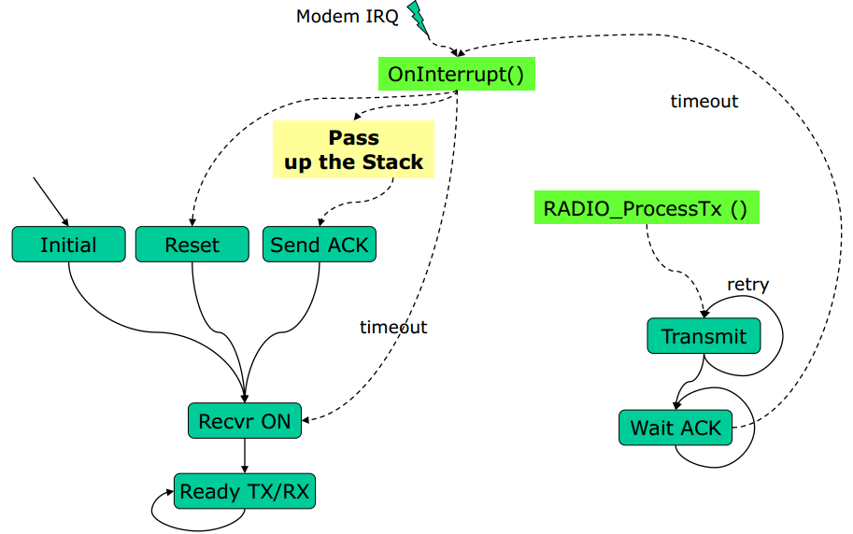
Radio State Diagram

